Slide 1

NDPERS Update
December 2025 Overview
ND County Commissioners Summit
MaryJo Anderson, Defined Benefit Retirement Programs Manager

Slide 2
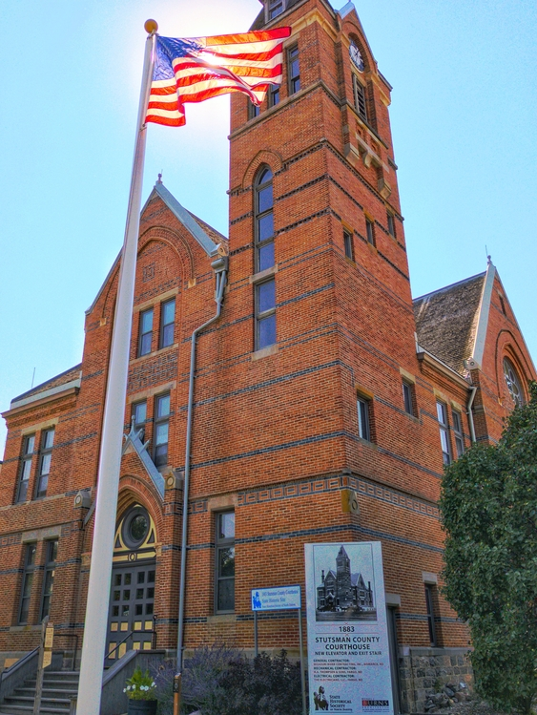
Agenda
Public Safety Plan Updates
Elected County Official Updates

Slide 3
Public Safety With vs. Public Safety Without
Includes peace officers, correctional officers, firefighters, dispatchers, and emergency medical services

Slide 4
What is considered “full time”?
32-40 hours per week: Mandatory Participation
working 32 hours per week for 20 or more weeks
18 years of age
Permanent, regularly funded position (not of limited duration)
20-31 hours per week: Mandatory Non-Public Safety Participation
Upon meeting 32 hours per week in a permanent position can be enrolled in PS Plan
Less than 20 hours per week or Temporary Position: Optional Participation
Employee can elect to participate at their own expense into a non-public safety plan
Enroll in non-public safety plan
Waivers found in the New Hire form packet online

Slide 5
HB 1177 Correctional Officer Definition
Revised Correctional Officer definition
Allows Correctional Officers (without certification) to be enrolled in the Public Safety Plan if enrolled in, but has not yet completed, a correctional officer course approved or certified by the NDDOCR
Notice provided from NDPERS to authorized agents in June and July by email blast to update any employees eligible for 8/1

Slide 6
HB 1419 Dispatchers and EMS
Each county must make an active election to include newly eligible positions.
Board Resolution – resolution language can be provided by PERS
Public Safety employer agreement
Record of Service including eligible employees
Any counties not offering the Public Safety Plan or not electing to expand the plan to the newly eligible positions will continue to enroll employees in the applicable Main or DC 2025 plan according to your Benefit Enrollment Report.

Slide 7
Additional Public Safety Information
Any employee in a Public Safety Plan cannot be enrolled concurrently in any other NDPERS plan.
Normal Retirement age for all Public Safety plans is age 55. In order to meet IRS requirements for retirement prior to age 59 ½, termination must be bona fide.
Not yet enrolled with Public Safety? Contact NDPERS!

Slide 8
Upcoming Rate Changes for 1/1/2026
Public Safety With Prior Service
Public Safety Without Prior Service
19.27% total
5.5% Employee
12.63% Employer (increase of 1.23%)
15.45% total
5.5% Employee
8.81% Employer (decrease of 0.35%)

Slide 9
Elected County Official Updates

Slide 10

Conflict Discovered – March 2025
Internal Revenue Code (IRC)
NDCC 54-52-02.11 and NDCC 54-52.6-02.1(3)
Prohibits allowing a waiver of participation once an employee elects to join the retirement plan if the employee remains employed with the same employer in an eligible position.
Allows county elected officials at their individual option to enroll in NDPERS retirement plan within the first 6 months of their term.

Slide 11
Authority to Resolve Conflict
NDCC 54-52-23 provides NDPERS Board authority to address any section of NDCC chapter 54-52 that does not meet compliance with federal statutes or rules, subject to the approval of the employee benefits programs committee.
Plan modifications are effective until the effective date of any measure enacted by the legislative assembly providing the necessary amendments ensure compliance with the federal statutes or rules.
NDPERS Board wanted to create the least amount of disruption for members and employers while maintaining compliance with federal laws.

Slide 12
Conflict Resolution – May 13, 2025
Under obligation of NDCC 54-52-23, the NDPERS Board:
Adopted interim policies governing county elected officials’ participation in NDPERS retirement plans and allowing county elected officials to take in-service distributions in certain narrow circumstances
Directed staff to draft Emergency Administrative Rules confirming the Board’s adopted policies addressing the conflict to provide transparency and access to the information for the public and affected individuals
Directed staff to notify the Employee Benefits Programs Committee and seek approval of interim administrative rules until addressed by legislative assembly during next session
2 Policies Designed – (1) Existing & (2) New County Elected Officials

Slide 13
Policy #1 - Existing County Elected Officials Prior to May 13, 2025
County elected officials eligible for normal retirement may take in-service distributions in certain narrow circumstances
These officials may waive participation with their new term and begin receiving NDPERS retirement benefits while continuing to serving in their elected role
Policy is retroactive to January 1, 2007
Policy sunsets on August 1, 2027
Result: Retirement benefits will not be suspended and NDPERS will not request the return of retirement and retiree health insurance credit funds already paid to impacted county elected officials (10% penalty may apply).

Slide 14
Retirees are subject to IRS 10% penalty when:
Eligible for normal retirement but under the age of 59 ½
Reemployed by the same employer
Without a bona fide (31 day) break in service
Result:
1099-R Form will be coded as an “early distribution” for any retiree payments received prior to turning age 59 ½.

Slide 15
Policy # 2 - New Elected County Officials After May 13, 2025
Under federal CODA provisions, continued pre-tax contributions into the retirement plan is required if the employee remains with the same employer in an eligible position even if there is a break in service between the positions.
Policy resolves the conflict between federal and state law related to Cash or Deferred Arrangements (CODA) and their administration
Result: Requires participation in the NDPERS retirement plan when a newly elected county official meets mandatory participation
“Opt out” provision for county elected officials meeting mandatory participation will no longer be available (federal law trumps ND law)

Slide 16
Mandatory Participation
County elected officials meeting the following guidelines effective May 13, 2025 must participate in the retirement plan
At least 18 years of age
Permanent position that is regularly funded (not of limited duration)
Work a minimum of 20 hours per week for 20 or more weeks per year*
*Public Safety Plan - Work a minimum of 32 hours per week for 20 or more weeks per year (Includes: correctional officers, peace officers, firefighters, dispatch & emergency medical services)

Slide 17
Optional Participation: Temp or Part-time
County elected officials not meeting mandatory participation guidelines may participate after-tax at their own expense.
Must make an election within the first 180 days of new position.
ND law expressly prohibits the employer from paying any portion of an optional participant’s contribution.
May not participate as an optional participant in the NDPERS retirement plan if actively contributing to another employer sponsored plan (private or public).

Slide 18
Summary of Conflict Resolution
NDPERS Board adopted two policies
Board approved Emergency Administrative Rules
Governor approved Emergency Rulemaking request
Oct 30, 2025 - Employee Benefits Program Committee approved the Board’s interim final rules
Dec 3, 2025 - Administrative Rules Committee approved the Board’s interim final rules
2027 Legislative Session – propose legislation to formally add the NDPERS Board policy into law effective Aug 1, 2027

Slide 19
Questions?

